Slide 1
Impact and influence of gaming on teenagers
By Andrew Graff

Slide 2
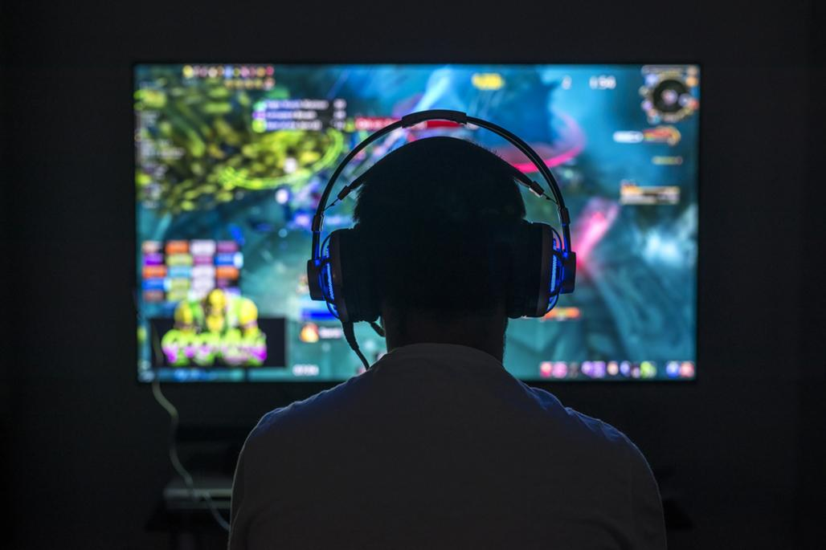
What is gaming?
Electronic or video games played on different devices;
Consoles/PS4/Xbox
Computers
Mobiles Phones/Tablets

Slide 3
Statistics
70% of American kids aged 18 and below are gamers (ESA,2020)
18 year olds play an average of 6.56 hours per gaming session (Limelight,2020)
Teenagers spend more than 8 and half hours online for entertainment (The Common Sense Census, 2021)
76% of 5,000 11-15 year olds talk to their friends about gaming and build better social connections (CBBC, 2020)
Largest study ever done on teenage video game addiction showed males who spend too much gaming show more negative consequences on a social level with females experiencing negative emotional states (NLM, 2020)
Video gaming has shown to improve a teen capability of thinking (Qamar, 2023)
Video gaming builds stronger connections between friends (Pew Research Center’s Teens Relationships Survey, 2014)

Slide 4
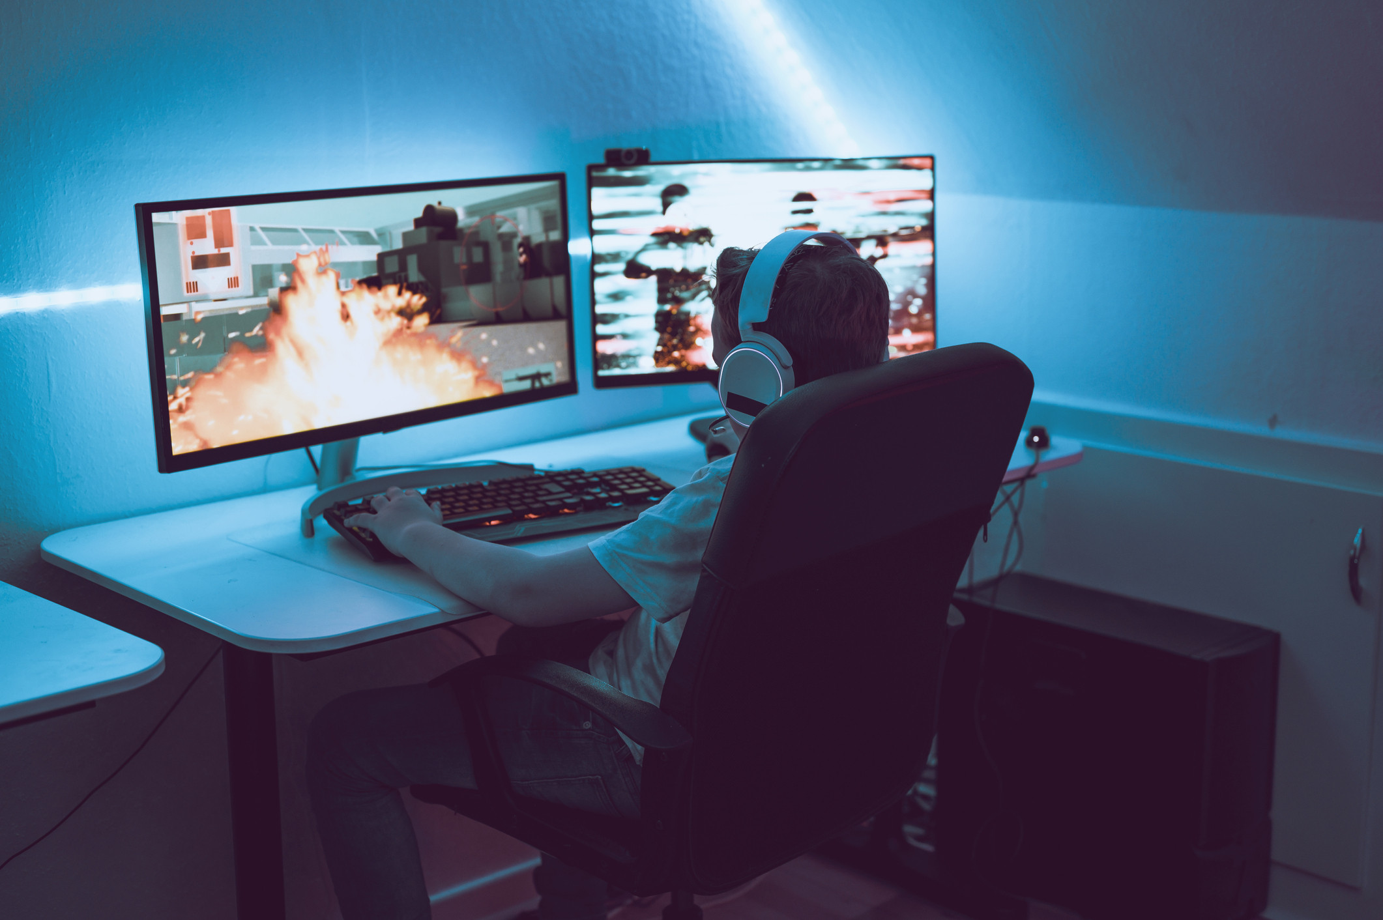
Impacts
Gamers thumb (result of moving tendons for long period of time
Loss of interest in other activities
Escape mechanism (avoiding reality)
Withdrawal
Time consumption
Addiction
(Grinspoon, 2020)

Slide 5

positive impacts
Faster and accurate decision making
Attention to detail (improved eye sight)
Multi Tasking
Pro social behaviours
Enhance problem solving and logic
(Adair, 2015)

Slide 6

Influence
Tyler Blevins also known as Ninja
Rose to fame streaming his 12 hours computer gaming sessions playing fortnite
Majority of his audience fan base were teenagers (amassing over 50 million across platforms)
Generated over $6 million alone from YouTube
(Hore, 2022)

Slide 7

Influence
In June 25, 2003
A group of families sued the makers of this popular game (on the left) for inspiring two teenage boys to fatally shoot one motorist and seriously wound another
Teenage stepbrothers were playing this game when they took their parents rifle and shot into traffic
Although the claim was dismissed with no substantial evidence due to the firearm being accessible
We can see how influential violent games can be
(Roach, 2003)

Slide 8
Conclusion
So we have explored the impacts and influence of gaming on teenagers. From research and experience I can understand the not so positive side effects of gaming. I too have once played the game far too long.
We do see the benefits of the game which I would like to add “is the escape mechanism, from reality for a brief moment in time”.
All in moderation.

Slide 9
Referencing
(Adair, 2014) | Adair, C. (2014). 11 Positive Effects of Video Games. 11 Positive Effects of Video Games (gamequitters.com)
(CBBC, 2020) | CBBC. (2020, August 12). New research suggests playing video games has lots of benefits. New research suggests playing video games has lots of benefits - BBC Newsround
(Coyne et al., 2020) | Coyne, S et al,. (2020, July). PubMed Advance. Pathological video game symptoms from adolescence to emerging adulthood: A 6-year longitudinal study of trajectories, predictors, and outcomes - PubMed (nih.gov)
(ESA,2020) | ESA (2020). Gamers’ User Profile. Number of Gamers Worldwide 2022/2023: Demographics, Statistics, and Predictions - Financesonline.com
(Grinspoon, 2020) | Grinspoon, P. (2020, December 22). The health effects of too much gaming. The health effects of too much gaming - Harvard Health
(Hore, 2022) | Hore, J. (2022). Who is Ninja?. Who is Ninja? Net worth, earnings, streaming setup, and more | The Loadout
(Limelight, 2020) | Limelight (2020). Average hours gamers spent playing video games a week by country worldwide in 2020. Number of Gamers Worldwide 2022/2023: Demographics, Statistics, and Predictions - Financesonline.com
(Roach, 2003) | Roach, D. (2003, October 27). Violent video game alleged as cause of teens’ shooting spree. Violent video game alleged as cause of teens' shooting spree | Baptist Press
(Qamar, 2023) | Qamar, S. (2023, February 17). 4 Stages of Intellectual Development in Children. 4 Stages of Intellectual Development In Children (momjunction.com)
(The Common Sense Census, 2021) | The Common Sense Census (2021). The Common Sense Census. 8-18-census-integrated-report-final-web_0.pdf (commonsensemedia.org)

